Slide 1


Library Management System
This presentation introduces our Library Management System, developed in C language for BCA students. It highlights core programming concepts through a practical application.
Notes:
1.7.2013
1
‹#›

Slide 2


Introduction to the Project
Core Functionality
C Language Development
This project is a Library Management System.
Developed using the C programming language.
Fundamental Concepts
It demonstrates structures, file handling, and basic I/O.
This system showcases how C can manage data efficiently, a crucial skill for computer science students. It provides a foundational understanding of practical software development.
Notes:
1.7.2013
2
‹#›

Slide 3







Key Features Overview
Add a Book
Display All Books
Search by ID
Update Information
Easily add new book records.
View the entire book catalog.
Quickly find books by their unique ID.
Modify existing book details.
Issue Book
Delete a Book
Save Data
Record the issuance of books to library patrons, tracking availability.
Remove outdated book entries.
Utilizes robust file handling.
These features cover essential CRUD operations, providing a complete and functional library management experience. Each function is designed for user-friendly interaction.
Notes:
1.7.2013
3
‹#›

Slide 4





Technologies Utilized
The project is primarily developed in C. It uses standard file I/O functions. This ensures cross-platform compatibility. The program runs on Windows.
Language:
C
Compiler: GCC
File Handling
Robust and efficient programming language.
Standard GNU Compiler Collection.
Binary mode for efficient data storage.
Platform: Windows
Developed and tested on Windows OS.
Notes:
1.7.2013
4
‹#›

Slide 5
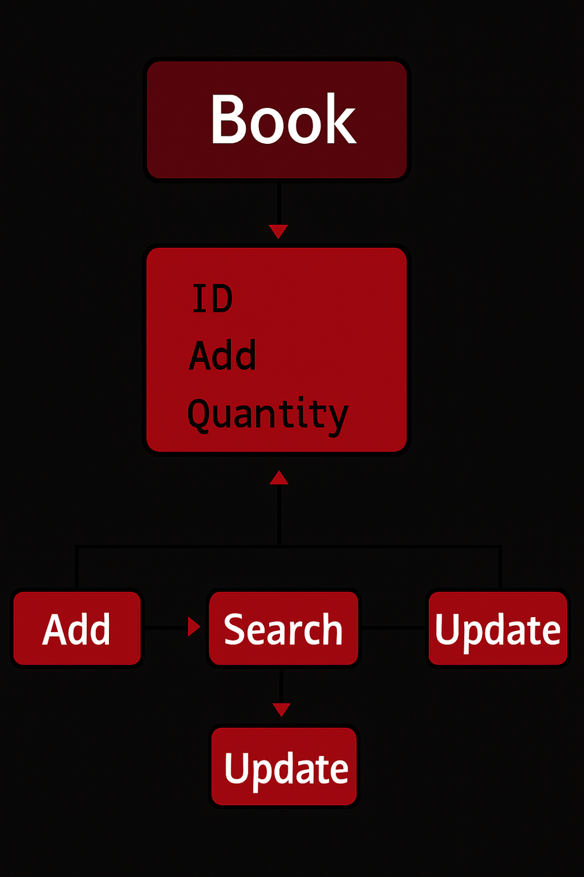


Program Code Structure
Book Structure
Defines book attributes.
ID
Title
Author
Quantity
Price
Book Issue
Modular Functions
Each feature is a distinct function.
Add Book
Display Books
Search Book
Update Book
Issued Books
Delete Book
The modular design enhances readability and maintainability. This structure facilitates easy expansion and debugging for future enhancements.
Notes:
1.7.2013
5
‹#›

Slide 6

Sample Output
The following table provides a snapshot of how book data is displayed within the Library Management System. This output format ensures clarity and readability, allowing users to quickly grasp key information about each book.
ID
Title
Author
Qty
Price
Book Issued
101
Programming in ANSI C
E Balaguruswami
5
550.00
2
102
OOPS With C++
Reema Thareja
3
450.00
1
This structured presentation of data facilitates easy monitoring of book availability and detailed record-keeping within the library, crucial for efficient management.
Notes:
6

Slide 7



Conclusion and Team
This project is an excellent example of file-based data handling in C. It teaches key programming skills and demonstrates real-time application design.
This C Project is submitted by BCA students under the guidance of
Gautam Sir
Avish Kumar Saluja
Ritesh Kumar
Suryanshu Suman
Roll No. 09
Roll No. 46
Roll No. 17
Notes:
1.7.2013
7
‹#›

